Slide 1
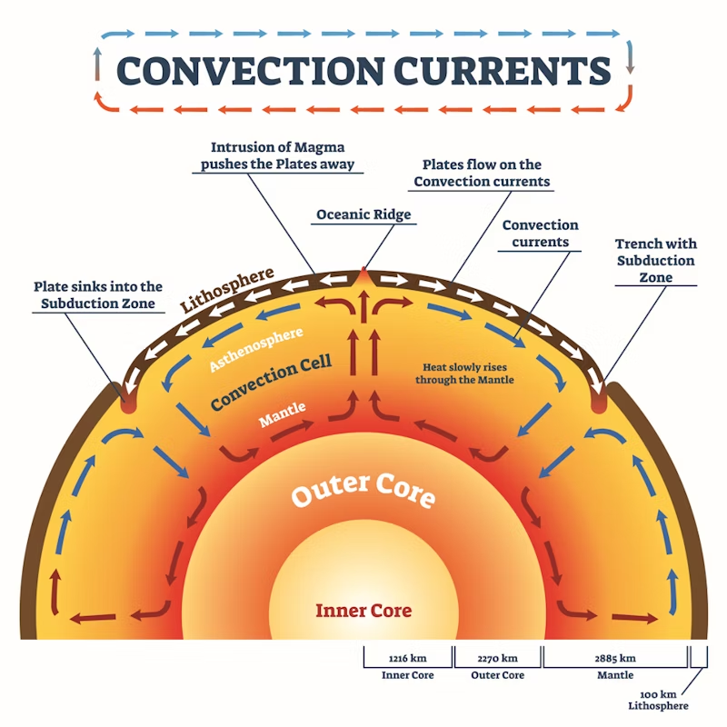
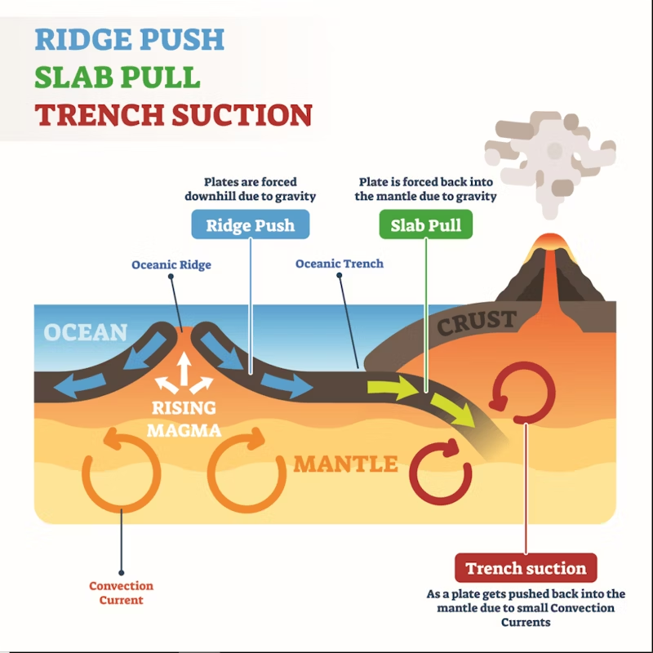
How do tectonic plates move?
This is a controversial debate in geography with scientists struggling to agree about what actually makes tectonic plates move.
Convection currents
The most well-known theory is convection. Deep in the Earth’s core, temperatures reach about 6,000 °C, which makes the magma (hot, melted rock) rise through the mantle. As it moves up, it cools and sinks back down. These currents push against the lithosphere and can carry tectonic plates with them.
For a long time, this idea was widely accepted, even though there was only a little evidence. Modern imaging hasn’t been able to find convection currents big enough to move the plates, so this theory is now mostly discredited.
Ridge Push and Slab Pull
The most widely accepted theory today is ridge push and slab pull.
At constructive margins (where plates move away from each other), ocean ridges rise above the ocean floor. Here the mantle melts to form magma, which rises, cools, and creates new oceanic lithosphere. This new rock is less dense than the asthenosphere, but as it cools and thickens, it becomes denser.
The further this new material moves from the ridge, the more it thickens. This forms underwater mountains and rifts, and makes the boundary between the solid lithosphere and the softer, flowing
asthenosphere slope downwards. Gravity then pushes the older plate away from the ridge. This process is called ridge push.
At destructive margins, the new oceanic lithosphere is forced below a continental plate at a subduction zone. The plate sinks under its own weight into the mantle, pulling the rest of the plate with it. This process is called slab pull.

Slide 2

How do tectonic plates move?
In geography, scientists still argue because they find it hard to agree what makes tectonic plates move.
Convection currents
The most common theory is convection. In the Earth’s core, temperatures reach about 6,000 °C, which makes the magma (hot, melted rock) rise through the mantle. As it goes up, it cools and then sinks again. These currents push on the lithosphere and can move the tectonic plates.
For many years, this theory was accepted, even though there was little evidence. Modern imaging has not found convection currents large enough to move the plates, so the idea is now mostly discredited.
Ridge Push and Slab Pull
The most accepted theory today is ridge push and slab pull.
At constructive margins (where plates move apart), ocean ridges rise above the sea floor. Here the mantle melts to form magma, which rises, cools, and creates new oceanic lithosphere. This new rock is less dense than the asthenosphere, but as it cools and thickens it becomes denser.
As this new material moves away from the ridge, it gets thicker. This creates underwater mountains and rifts, and makes the boundary between the solid lithosphere and the softer
asthenosphere slope downwards. Gravity then pushes the older plate away from the ridge. This is called ridge push.
At destructive margins, the new oceanic lithosphere is pushed under a continental plate at a subduction zone. The plate sinks into the mantle under its own weight, pulling the rest of the plate with it. This process is called slab pull.

